Slide 1
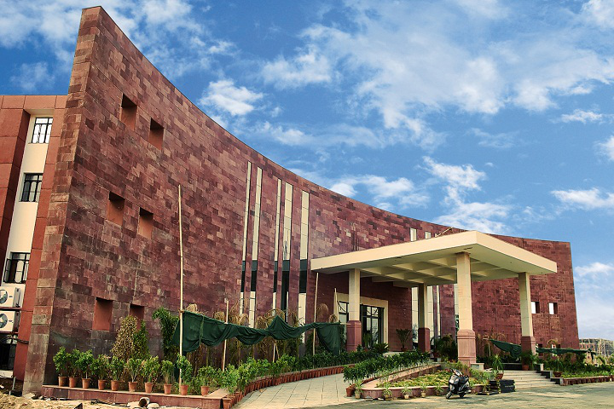

Poornima University
Project:- Friendly Chat Bot

Slide 2

Project:- Friendly Chatbot
Reg no.
Name
Branch
Team Leader
2020PUSCEBAIX08945
Anil Kumar Saini
B. Tech cs(AI)
Team Member
2020PUSCEBAIX08645
Pratham Goyal
B. Tech cs(AI)
2020PUSCEBAIX08719
Rani Rathore
B. Tech cs(AI)
2020PUSCEBAIX08477
Ronak Verma
B. Tech cs(AI)

Slide 3
Friendly Chatbot
Abstract
A chatbot is an intelligent piece of software that is capable of communicating and performing actions similar to a human. Chatbots are used a lot in customer interaction, marketing on social network sites and instantly messaging the client.
Almost 30 percent of the tasks are performed by the chatbots in any company. Companies employ these chatbots for services like customer support, to deliver information, etc.
We have tried to create a Chatbot that could do some basic tasks and answer to some questions.
The User can either type the question or can use the voice command mode and the bot will try to answer the question or perform the task that the user wants

Slide 4
Research Methodology
We made a Chatbot using NLTK library and python text to speech -:
so we need to do some research on NLTK and converting text to speech and recognizing text.
We looked on several sites and resources to learn more about functioning of NLTK and pyttsx3 and speech recognition functions fo python
The chatbot can give some good replies so we have made hard coded replies in intents.json file where the bot will try to recognise the tag and give reply according to it.
Along with it some operations are also added like opening web pages, searching meaning etc.

Slide 5
The User will enter the input like a operation or conversation.
2. Then the Bot will try to recognize whether it is a conversation or a task.
3. If the given input is task, it will perform the task and will print the result in chatbot window(gui)
otherwise it will try to give reply from the intents file
hardcoded responses are present.
4. After completing this, the user can again enter a command and this whole process will repeat again.

Slide 6
FLOWCHART

Slide 7
Tools And Technology
Python
Pycharm
Nltk
Keras
Speech Recognition
Text to Speech
Tensor Flow

Slide 8
Python :
Python is an interpreted high-level general-purpose programming language. Its design philosophy
emphasizes code readability with its use of significant indentation. Its language constructs as well as
its object-oriented approach aim to help programmers write clear, logical code for small and large-scale
projects.
NLTK is a toolkit build for working with NLP in Python. It provides us various text processing libraries
with a lot of test datasets. A variety of tasks can be performed using NLTK such as tokenizing, parse tree
visualization, etc.
Nltk :
Speech Recognition in python is a library which allows the program to recognize the verbal voice of humans and decode it to text.
It can also be said as Speech to text.
Speech Recognition
:

Slide 9
:
Python Text to speech (pyttsx3) is a library in python which converts the text to audio format.
Text to speech
TensorFlow is an end-to-end open source platform for machine learning. It has a comprehensive,
flexible ecosystem of tools, libraries and community resources that lets researchers push the state-
of-the-art in ML and developers easily build and deploy ML powered applications.
Tensor Flow :
Keras is an API designed for human beings, not machines. Keras follows best practices for reducing
cognitive load: it offers consistent & simple APIs, it minimizes the number of user actions required
for common use cases, and it provides clear & actionable error messages. It also has extensive
documentation and developer guides.
Keras :

Slide 10
Result Overview
Chatbot is working quite well and giving some simple answers and performing some simple tasks .
We will try to update and made some more changes to make it better so that it can perform more operations.
Many changes can be made it in like it can give any answer by searching from google and scrapping answer from there along with a good GUI.

Slide 11
Resources
Learning NLTK:
https://data-flair.training/blogs/nltk-python-tutorial/
https://www.youtube.com/watch?v=X2vAabgKiuM
Python text to speech (pyttsx):
https://pypi.org/project/pyttsx3/
Speech Recognition:
https://realpython.com/python-speech-recognition/

Slide 12
Thank You

